Slide 1
Knowledge Share – PathFinder DB
May 26, 2014

Slide 2
Agenda
Schema
Database configuration
Source Code
How to access Path Finder DB
Bug

Slide 3
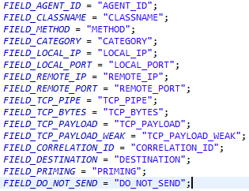
Schema
Support 5 databases
Derby
Oraclex
MySql
MSSql
DB2
\main\lisa_remote\dist\database
Table
LISA_TRANSACTION_FRAME
LISA_FRAME_DATA
LISA_FRAME_TAGS
LISA_FRAME_FLAGS
LISA_FRAME_SHARED

Slide 4
Configuration
Site.properties and Lisa.properties
lisadb.pool.common.driverClass=
lisadb.pool.common.url=
lisadb.pool.common.user=
lisadb.pool.common.password_enc= //AES algorithm
lisadb.pool.common.minPoolSize=
lisadb.pool.common.initialPoolSize
lisadb.pool.common.maxPoolSize=
lisadb.pool.common.acquireIncrement=
lisadb.pool.common.maxIdleTime=
lisadb.pool.common.idleConnectionTestPeriod=
2. Seems the site.properties is discarded.

Slide 5
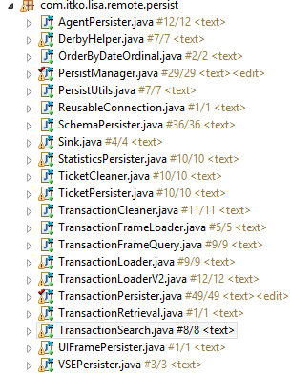
Source file
PersistManager.java
TransactionPersister.java
SchemaPersister.java
TransactionLoader.java / TransactionLoaderV2.java

Slide 6
How to access Path Finder DB
JMS, JMSMethodInvocation, bash
AgentClient, TransactionsClient
Debug

Slide 7
Bug
Failed to import paths.
As my test, you will be successful for the first time, but always failed afterward.
[LISA AGENT:BC][ERROR][4168][715][qtp1328025401-715][May 24, 2014 8:04:20 PM] FindFrames exception: Syntax error: Encountered ")" at line 1, column 81.
Cannot delete frames for a specific agent
cascade

Slide 8
Clear old transactions
Create extension tool
Use embed functionality(TransactionCleaner.java)
transaction_cleaner_enabled
transaction_cleaner_age

Slide 9
Q&A

